Slide 1

Client Side Scripting
Mandy Farrugia

Slide 2


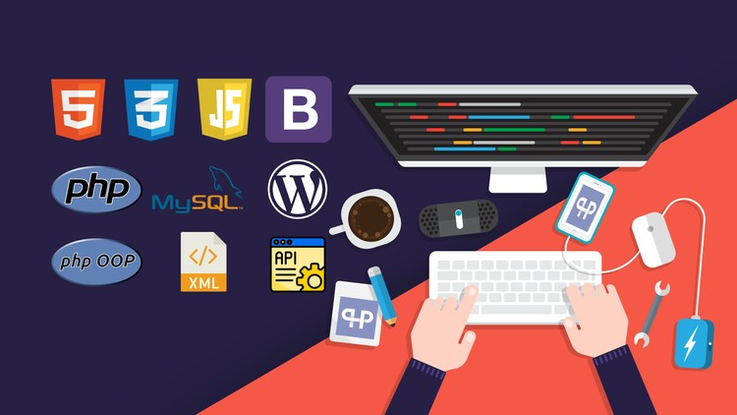
Welcome to Client Side Scripting!
The end goal of this unit is to fuse client-side web technologies to create a web application. There also exist several client side frameworks such as Bootstrap and Ionic. For this unit, we will be focusing on HTML, CSS, and if need be JavaScript.

Slide 3


About me
I acquired the Diploma in IT (MQF Level 3) in February 2019 where I familiarized myself with website design and development and C# (mainly Windows Forms and Console .NET Framework). I am currently following my second and last year of the Advanced Diploma in IT (Software Development).
As a 19-year old software development enthusiast, I experiment with Java, C#, Unity, HTML, CSS, JavaScript, jQuery, PHP and SQL.

Slide 4



My goals before turning 20
Exploring web scraping technologies via Selenium and C#/Java, as well as Beautiful Soup and Python.
Continue working on my C# .NET library Mauren. (This contains a lot of ready-made code to aid with string manipulation, arithmetic operations and user input)
Enhance my Pacman Unity project by spawning dots and ghosts at runtime.
Build a database managed system (maybe a COVID-19 tracking system).
Inspire Maltese netizens to familiarize themselves with coding as I believe it hones critical thinking skills.

Slide 5


Work Experience
Junior Content Writer at Volo Media, Mellieħa (19th August 2019 – 27th September 2019)
Data Entry Clerk at Identity Malta Agency, Msida (13th July 2020 – 25th September 2020)

Slide 6
What is client-side scripting? Why is it used?
Client-side scripting refers to executing scripts on a browser running on a desktop computer, laptop, tablet or smartphone. Client-side also refers to any visible content inside the browser, such as elements (block of text, images, lists), as well as events being triggered (the behavior of a website which is normally defined in JavaScript). Usually, scripts are linked to an HTML file (this defines the structure of a webpage). The HTML defines how the elements are placed in a webpage, whereas CSS defines how the elements are stylized, whereas JavaScript defines how the webpage and its elements behave (such an event being triggered at the click of a button, as well as handling form validation to prevent user from submitting forms with incomplete fields). The focal point of client-side scripting is to render a user-friendly and functional website.

Slide 7

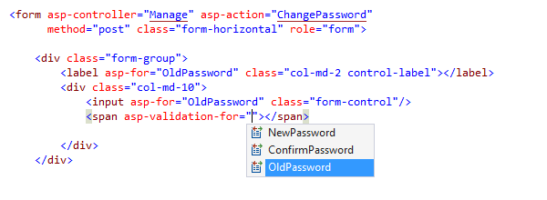
Advantages of client-side scripting
Client-side scripting allows easy and quick form validation whereby the page does not need to be reloaded. Submission events can be fired to prevent user from submitting if any fields are incomplete.
Execution is faster as no server is required to execute the scripts.
Scripts, stylesheets and HTML files are accessible within the browser via developer tools. The client would be able to modify the files.

Slide 8
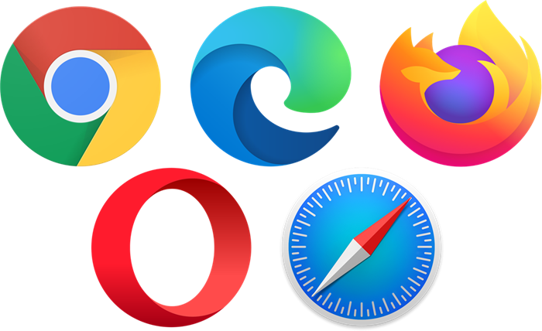
Web browsers
In its simplest terms, a web browser (otherwise shortened to the term browser) is a software application enabling access of information on the World Wide Web. Whenever the user requests to access a webpage of a website (through search engines or address bar), a web server will retrieve the contents of the web page which is subsequently displayed on the user’s device. To date, the most popular browser is Google Chrome. Nowadays, browsers are available for a plethora of devices, namely desktop PCs, laptops, smartphones, tablets and even the Raspberry Pi.

Slide 9

Google Chrome
Google Chrome offers a plethora of web developer tools (particularly device toolbar to ensure the responsiveness of a website on smaller devices and Console toolbar to debug and test JavaScript code, as well change HTML elements and styling).
Moreover, Google Chrome comes with a Task Manager where users can see how many resources (CPU usage and memory) are allocated to each tab and extension. One can easily eliminate a tab, otherwise known as a process, in case of misbehaviour.

Slide 10
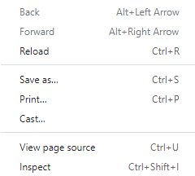
How to access developer tools in Google Chrome…
Ctrl+U to view the HTML (as well as inline CSS/JavaScript code, i.e: CSS/JavaScript embedded into HTML via style/script) code.
Ctrl+Shift+I to access developer tools.
You can either using the key combinations above or navigate to said options within the context menu.

Slide 11
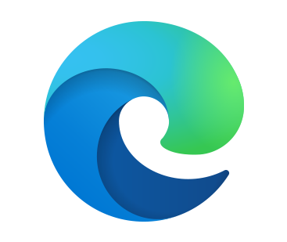
Microsoft Edge
Microsoft Edge, a cross-platform browser developed by Microsoft, has recently introduced Vertical Tabs. This is advantageous when it comes to several currently open tabs. The user will thus be able to tell between tabs by means of this newly introduced feature, preventing them from accidentally closing the wrong tab. The user can easily toggle between horizontal and vertical tabs with a single click.
As of June 2020, Microsoft Edge has become available for Windows 7, Windows 8.1 users. Unfortunately, no official version is available for Chromebooks and Linux yet as of October 2020. It was originally developed for Windows 10 back in 2015. It was then rendered compatible with Android and iOS in 2017, as well as macOS in 2019.
Microsoft Edge, now based on Chromium and supports a plethora of Google Chrome extensions, has been re-enhanced in a way whereby pages load faster, and all the same preventing the browser from putting a load on the computer resources, mainly memory and CPU, as a result of having eliminated obsolete web technologies.
With the click of a button, one can also utilize the distraction-free reading method known as Immersive Reader. All advertisements and any element considered a distraction will be removed.

Slide 12
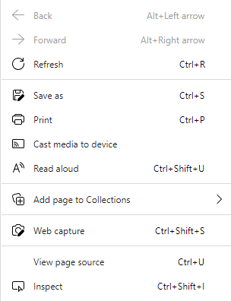
How to access developer tools in Microsoft Edge…
Ctrl+U to view the HTML (as well as inline CSS/JavaScript code, i.e: CSS/JavaScript embedded into HTML via style/script) code.
Ctrl+Shift+I to access developer tools.
You can either using the key combinations above or navigate to said options within the context menu.

Slide 13

Opera
Opera’s ad-blocker allows faster browsing activity by 90% as the browser is loaded without any advertisements, without the use of add-ons. This feature was initially available for the developer counterpart but was subsequently implemented on stable versions of Opera.
Opera is also ideal to be run on poor wireless connections as Opera Turbo allows up to 15% faster browsing activity. The browser also comes with a free and unlimited VPN, as well as power saving features to help prolong battery life.

Slide 14
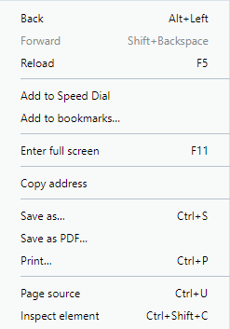
How to access developer tools in Opera…
Ctrl+U to view the HTML (as well as inline CSS/JavaScript code, i.e: CSS/JavaScript embedded into HTML via style/script) code.
Ctrl+Shift+C to access developer tools.
You can either using the key combinations above or navigate to said options within the context menu.

Slide 15
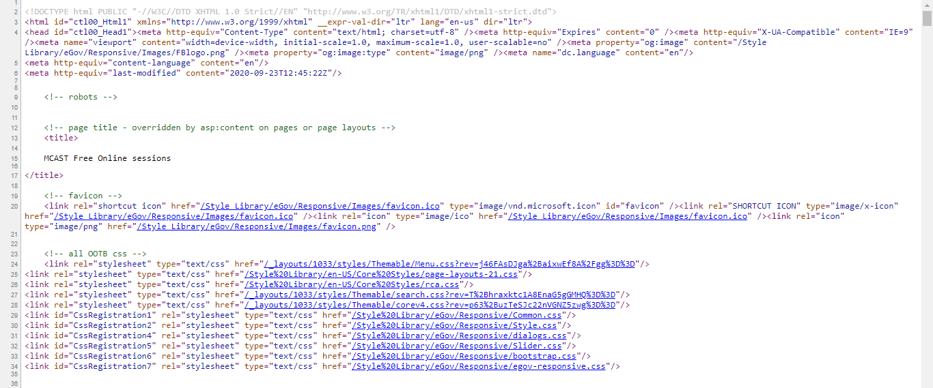
Viewing source code

Slide 16

What do you need for this unit?
Text editor to produce and maintain HTML, CSS and JavaScript code.
Visual Studio Code
Brackets
Atom
Sublime Text
I would not recommend Notepad and Notepad++ as it can be rather frustrating for beginners. I would highly suggest Visual Studio Code due to its built-in auto-save functionality, as well as automatic code suggestion, moreover there is a Live Server extension which works hand in hand with auto-save and changes are synchronized for every save.
A web browser to view changes.
Again, you can use any web browser of your choice but I strongly suggest Microsoft Edge. It is based on Google Chrome's lightweight and open-source counterpart, Chromium. It has website development tools, such as testing how your website would look like on certain devices such as iPhone X, iPad Pro, etc. Custom screen resolutions can also be taken into consideration.
Kindly note that all the text editors above, with the exception of Sublime Text, require Windows 7 or later.

Slide 17
Nota bene
Previous knowledge of HTML, CSS and JavaScript is NOT a prerequisite as I intend to start from the most rudimentary concepts possible.
The key to mastering website development is practice and maintaining a positive attitude! ☺
Examples will be available on GitHub for future reference. You are NOT required to use GitHub.
Do not be discouraged by errors! There is no standard learning curve, everyone learns at their own pace.
Sessions will be recorded and will be available via Client Side Scripting (2021) channel in Microsoft Teams.
“Many of life’s failures are people who did not realize how close they were to success when they gave up. “
“The greatest pity in life is giving up on achieving something you want without even trying.”
“Success is giving your all, the will to overcome any obstacle in life to achieve what you desire.”

Slide 18


Slide 19


